Slide 1

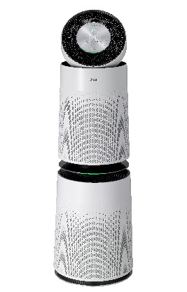
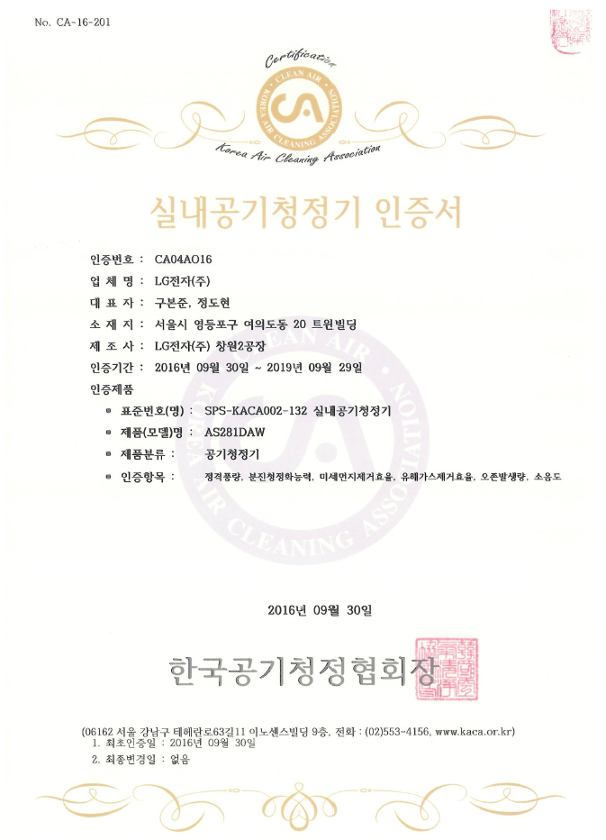
CA(Korea Air Cleaning Association)
Category | Test Content | Test Result | Test Organization
Filter Test | Reduce of 5 hazardous gas (Ammonia, acetic acid, acetaldehyde, toluene, formaldehyde) | Overall 99% elimination

Slide 2
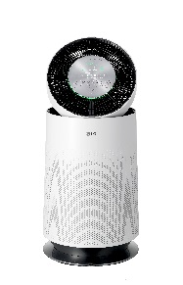
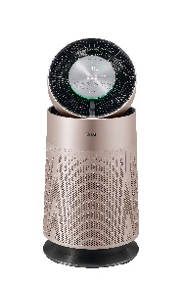
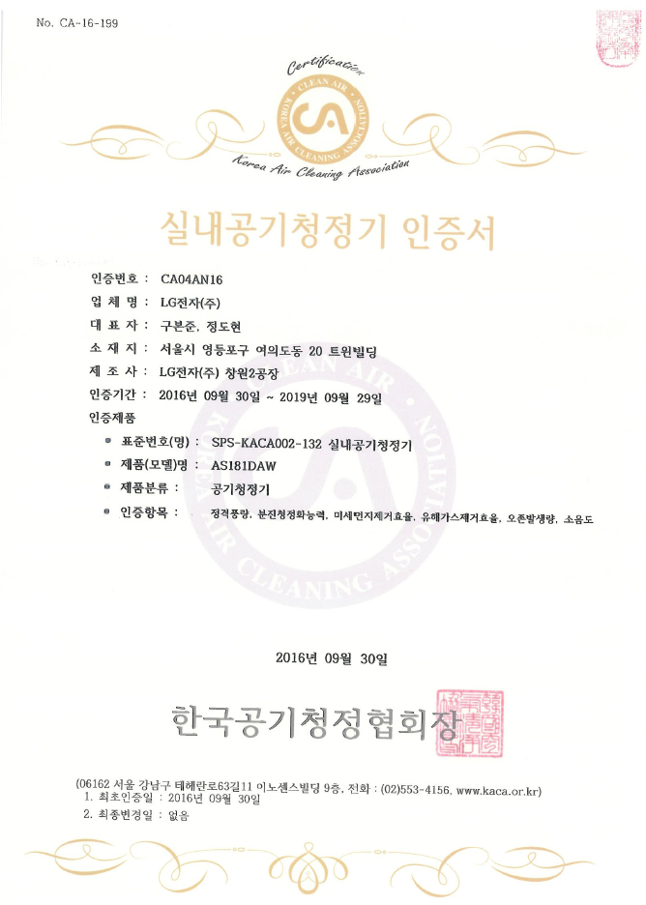
CA(Korea Air Cleaning Association)
Category | Test Content | Test Result | Test Organization
Filter Test | Reduce of 5 hazardous gas (Ammonia, acetic acid, acetaldehyde, toluene, formaldehyde) | Overall 95% elimination

Slide 3
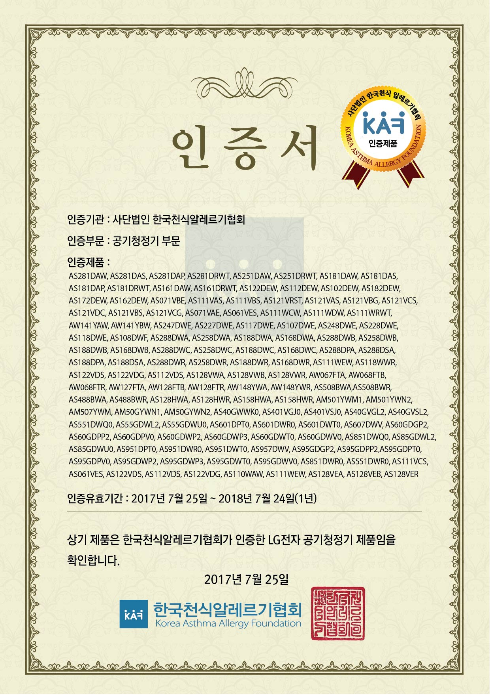
KAF(Korea Asthma & Allergy Association)
Category | Test Content | Test Result | Test Organization
Filter Test | Removal rate of dust including allergen | Overall 99% elimination

Slide 4
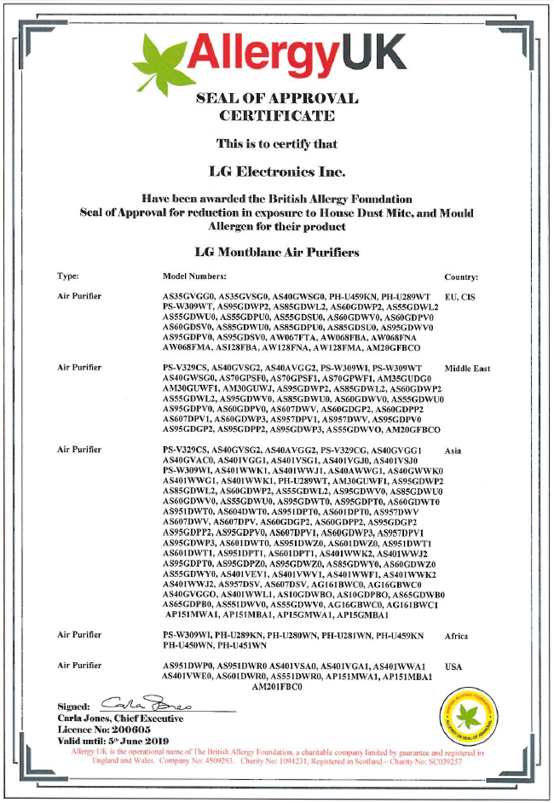
BAF(British Allergy Foundation)
Category | Test Content | Test Result | Test Organization
Filter Test | Reduce of allergy causing Substances through Dust filter | Certified | BAF

Slide 5
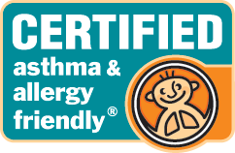
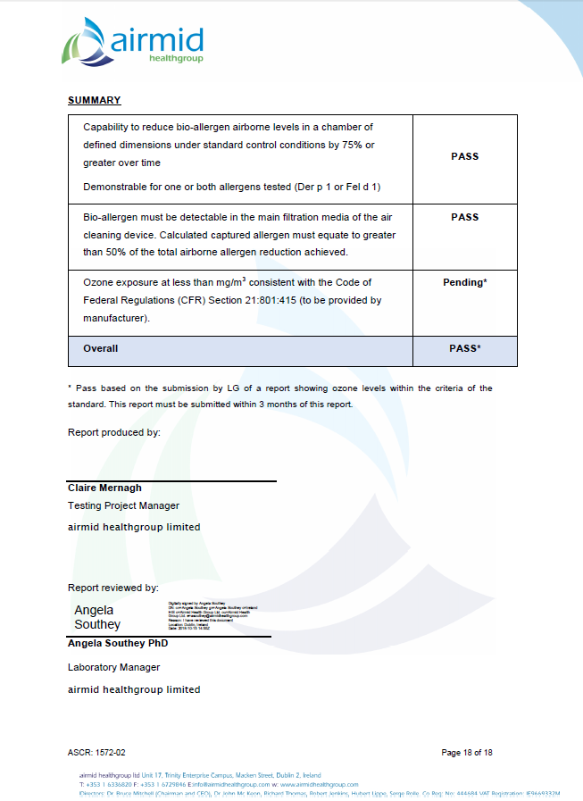
AAFA(Asthma & Allergy Foundation of America)
Category | Test Content | Test Result | Test Organization
Filter Test | Reduce of allergy causing Substances through Dust filter | Certified

Slide 6
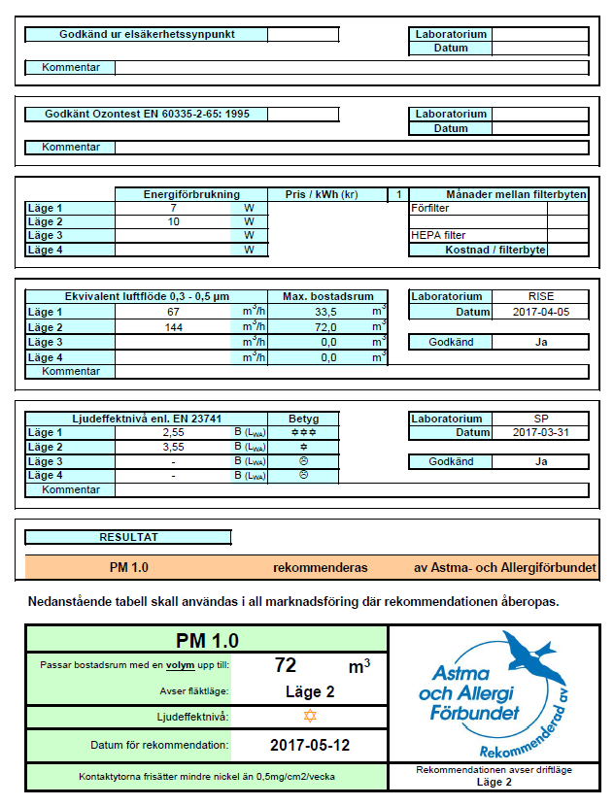
ASTMA(Sweden Asthma & Allergy Association)
Category | Test Content | Test Result | Test Organization
Filter Test | Reduce of allergy and asthma causing Substances through Dust filter | Certified | ASTMA

Slide 7
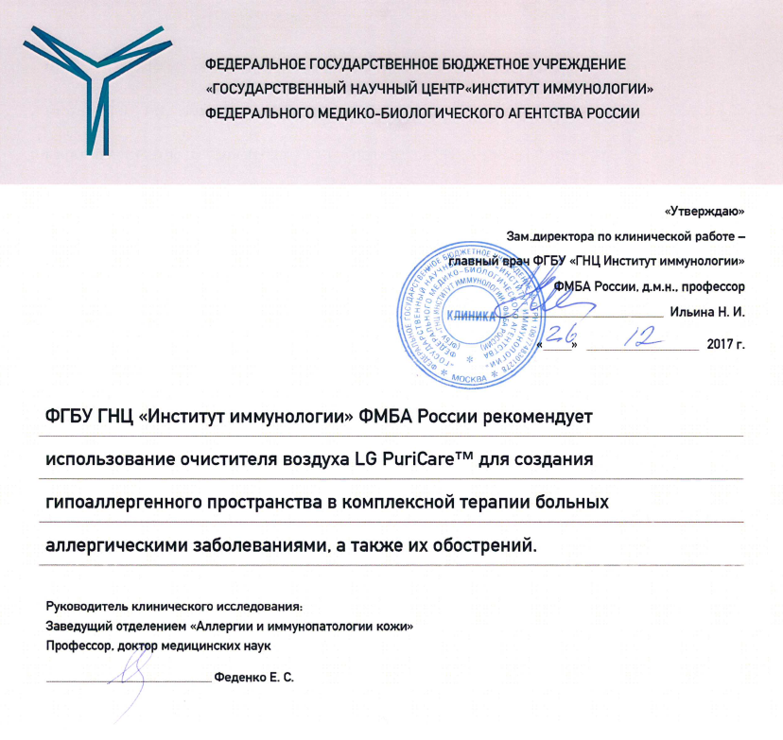
NRC Institute of Immunology FMBA of Russia
Category | Test Content | Test Result | Test Organization
Filter Test | Reduce of allergy and asthma causing Substances through Dust filter | Certified | Institute of Immunology

Slide 8
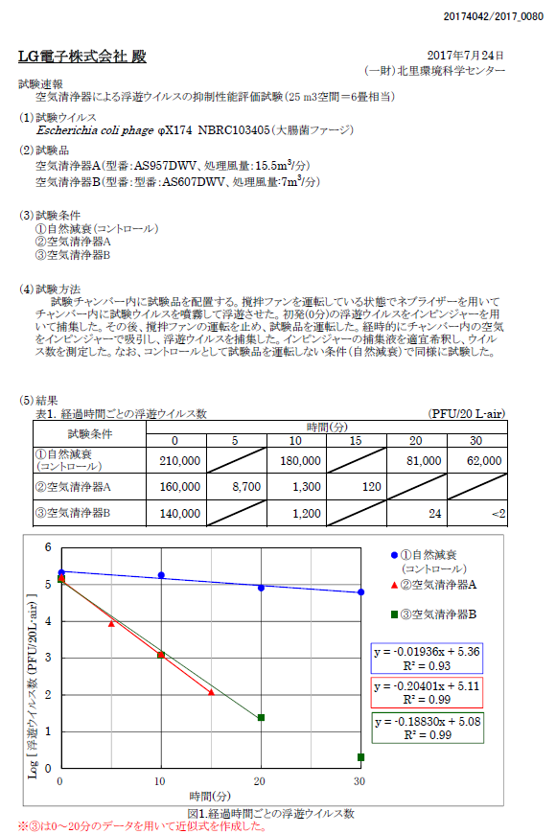
KITASO(Institute of Environmental Science Japan)
Category | Test Content | Test Result | Test Organization
Filter Test | Reduce of virus and floating bacteria | Overall 99% elimination in 15 minutes | KITASO

Slide 9
KITASO(Institute of Environmental Science Japan)
Category | Test Content | Test Result | Test Organization
Filter Test | Reduce of virus and floating bacteria | Overall 99% elimination in 20~30 minutes | KITASO

Slide 10
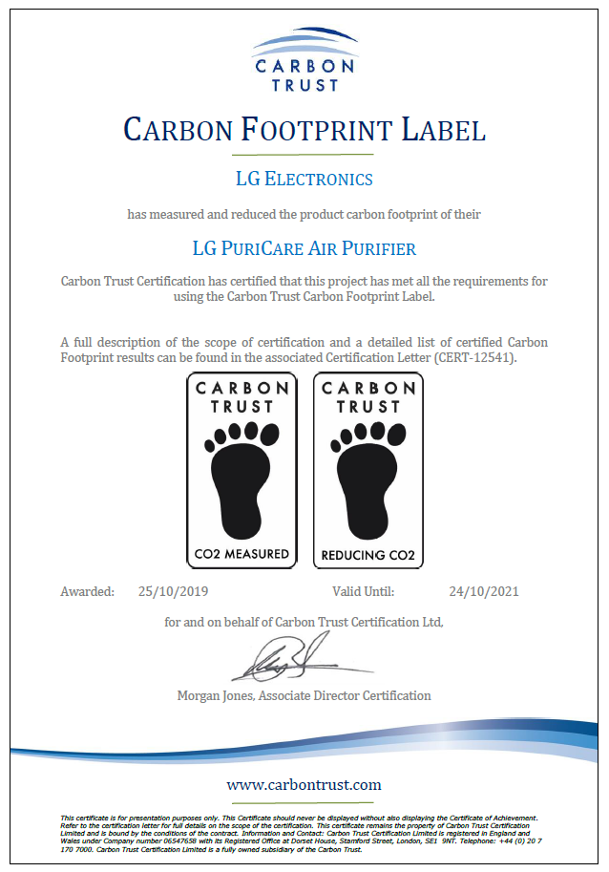
CARBON TRUST(British)
Category | Test Content | Test Result | Test Organization
Carbon Trust | Sustainability & carbon reduction for Business | Certified | CARBON TRUST

